Slide 1

Employee Data Analysis using Excel
STUDENT NAME: SUSHMITHA. E
REGISTER NO: 312200210
DEPARTMENT:COMMERCE
COLLEGE: South Indain Vaniyar Educational Trust
1
Notes:
1

Slide 2

PROJECT TITLE
Employee Performance Analysis using Excel
2

Slide 3



AGENDA
Problem Statement
Project Overview
End Users
Our Solution and Proposition
Dataset Description
Modelling Approach
Results and Discussion
Conclusion
3/21/2024 Annual Review
3

Slide 4

PROBLEM STATEMENT
We need to collect data on things like sales numbers, customer satisfaction, and project completion rates, and then use Excel to help us understand how each employee is doing. Basically, we want to use Excel to make sense of our employee performance data so we can make our team more awesome!
4

Slide 5

PROJECT OVERVIEW
.
Collect performance data (sales, customer satisfaction, project completion, etc.) Organize data in Excel (create tables, charts, and formulas) Analyze data to identify top performers and areas for improvement. Visualize data using dashboards and charts. Use data to inform performance evaluations and drive business decisions
5

Slide 6

WHO ARE THE END USERS?
1. HR Manager
2. Supervisor/ Manger
3. Department Heads
4.Executive Leadefrship
5. Training and development team
6. Compensation benefit team
6

Slide 7

OUR SOLUTION AND ITS VALUE PROPOSITION
SOLUTION
"Excel-based Employee Performance Analysis Toolkit"
VALUE PROPOSITION
- Easily track and analyze employee performance data in one place
- Automate calculations and visualizations to save time and reduce errors
- Gain actionable insights to inform performance evaluations, promotions, and development opportunities
7

Slide 8
Dataset Description
This dataset contains employee performance data, including metrics such as sales numbers, customer satisfaction ratings, project completion rates, and more. The data is organized in an Excel spreadsheet, with each row representing an individual employee and each column representing a specific performance metric.

Slide 9

THE "WOW" IN OUR SOLUTION
1. *Automated Calculations*
2. *Interactive Dashboards*
3. *Customizable Templates*
4. *Rea-time Updates*
5. *Drill-Down Capabilities*
6. *Data-Driven Insights*
7. *Scalability
8. *User-Friendly Interface*
9. Collaboration
10. *Actionable Recommendations*
3/21/2024 Annual Review
9

Slide 10
MODELLING
Use Excel to analyze employee performance by collecting data, calculating metrics, and visualizing trends. Evaluate performance against targets and create a rating system. Generate reports and dashboards to summarize findings and recommendations. Regularly update the analysis to track changes and inform data-driven decisions.
10

Slide 11
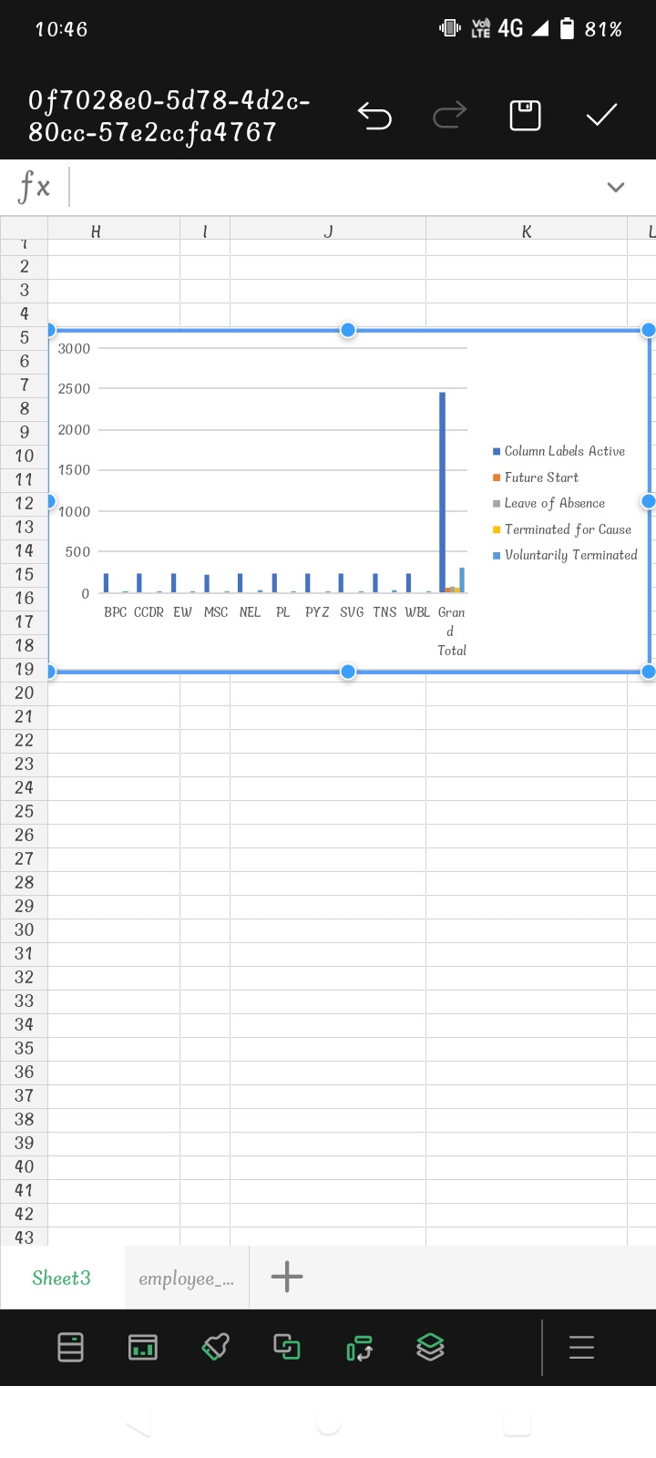
RESULTS
11

Slide 12
conclusion
"Using Excel for employee performance analysis helps organizations make data-driven decisions, improve performance, and drive business growth. It provides actionable insights, identifies top performers, and informs development programs. This leads to enhanced employee engagement and retention."

